Slide 1
Lab 5
TCP/IP Attack Lab
* The Lab #5 will be graded.
Notes:
The Lab #6 will be graded. Lab 6 looks at some popular TCP/IP Attacks,

Slide 2
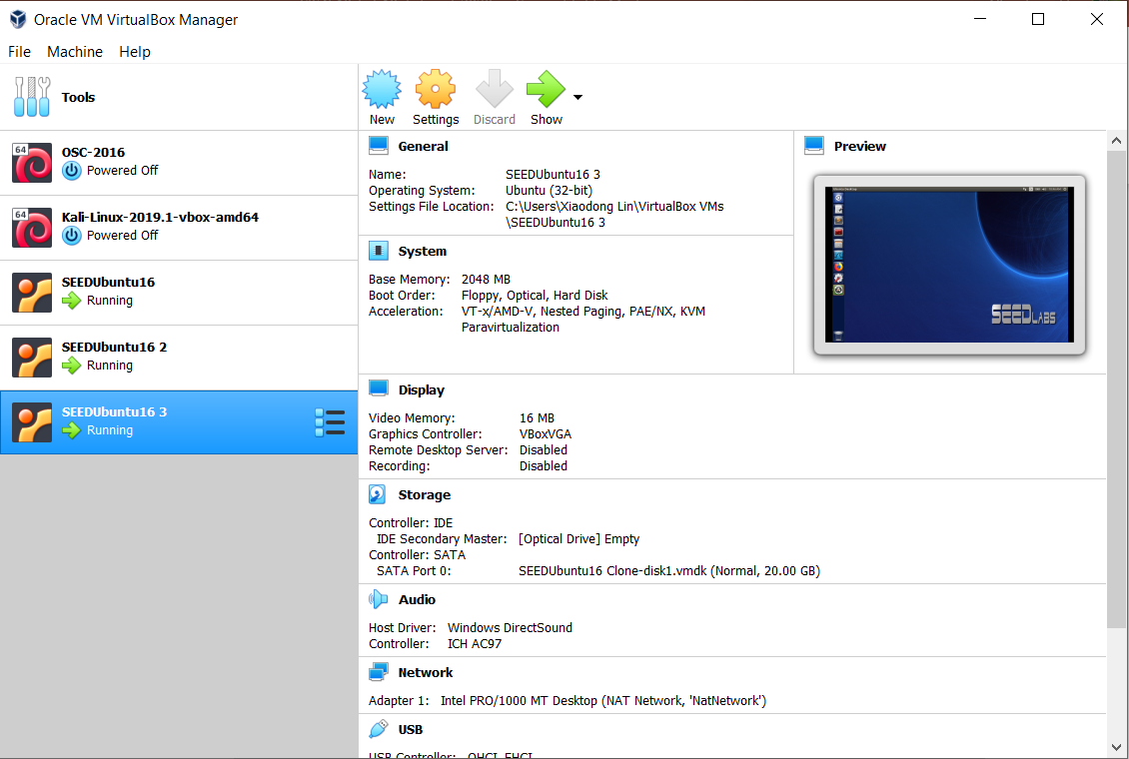
Due Friday, May 6, 2022 @ 11:59pm.
Notes:
For Lab 10, we will need all three VMs. It is due Friday, May 6, 2022 @ 11:59pm.

Slide 3
Task 1: Build Your Own Website
Notes:
The first task (or Task 1) is to build your own website.

Slide 4
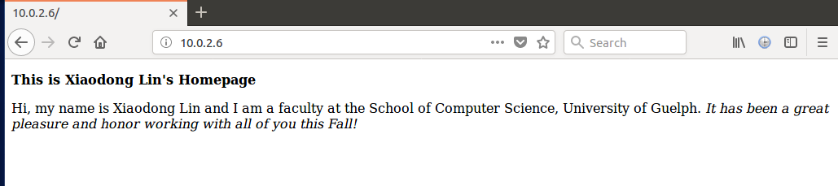
Example of personal web page
Note that your personal web page should provide a brief personal introduction about you that includes your name, in which year of your study are you, which program you are in.
Q1: Provide a screenshot of your personal web page.
Notes:
In Task 1, specifically, you are required to build a very simple personal website.
Your personal web page should provide a brief personal introduction about you that includes your name, in which year of your study are you, which program you are in. This is an example of personal web page for Dr. Lin.
You will need to provide a screenshot of your personal web page to demonstrate you have created your website on one VM.

Slide 5
Task 2: SYN Flooding Attack
Notes:
The second task (or Task 2) is to launch a SYN flooding attack on your own website.

Slide 6
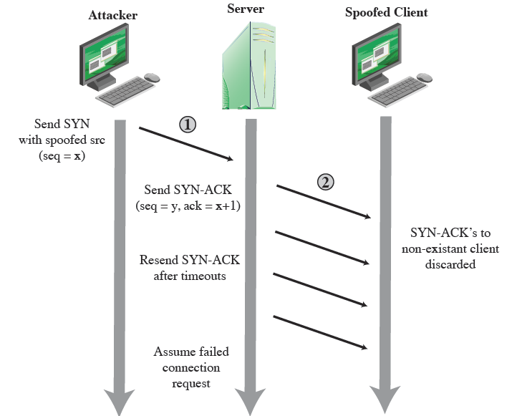
SYN Flood Attack and Defense
SYN cookies
Random deletion (drop)
Protect It!

Slide 7
SYN Flooding Attack
  Your personal website
Attacking VM
Target VM
Notes:
Specifically, you launch a SYN flooding attack on your own website from another VM.

Slide 8
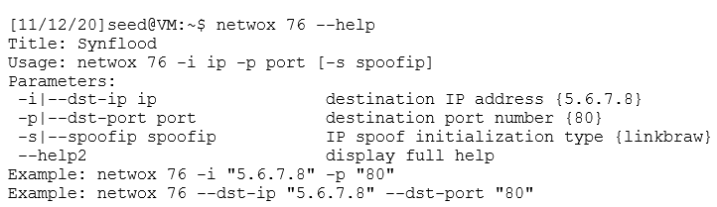
Netwox
Note that the Netwox tool requires you to have superuser privileges.
Notes:
The tool which you will be using for SYN flooding attacks is Netwox. Netwox is a toolbox for network administrators and network hackers.
Specifically, we use the No. 76 Netwox tool.
You can type "netwox 76 --help" to get the help information. The figure shows the usage of the Netwox Tool 76.
Note that the Netwox tool requires you to have superuser privileges.

Slide 9
Task 3: TCP RST Attacks on telnet Connections
Notes:
The third task (or Task 3) is to launch a TCP RST Attacks on an established telnet connection.

Slide 10

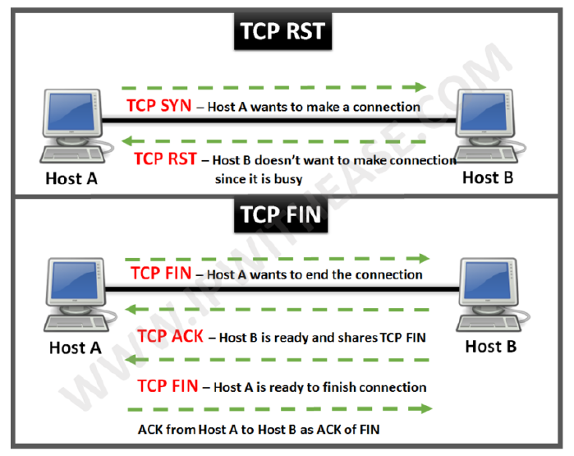
Closing a TCP Connection
Two ways to close a TCP Connection
FIN Packet (graceful closure)
- typically done when server / client wants to terminate the connection.
- 4 way handshake
RST Packet (abrupt closure)
- used when there is no time to do the FIN protocol
- errors in the transmission
- when under SYN attacks
Notes:
There are two ways to close a TCP Connection
FIN Packet (graceful closure)
- typically done when server / client wants to terminate the connection.
- 4 way handshake
RST Packet (abrupt closure)
- used when there is no time to do the FIN protocol

Slide 11
TCP Reset Attack
Consider a Telnet connection established between two systems.
  Telnet client
  Telnet server
Host A
forged TCP reset packet
Host B
attacker
Notes:
We look at how to terminate an established Telnet connection using a forged TCP reset packet.
Specifically, you first connect to one VM (or Telnet server) from another VM (or Telnet client). Afterwards, you use the third VM as the attacker to terminate the established Telnet connection by sending a forged TCP reset packet to either the Telnet client or the Telnet server.

Slide 12
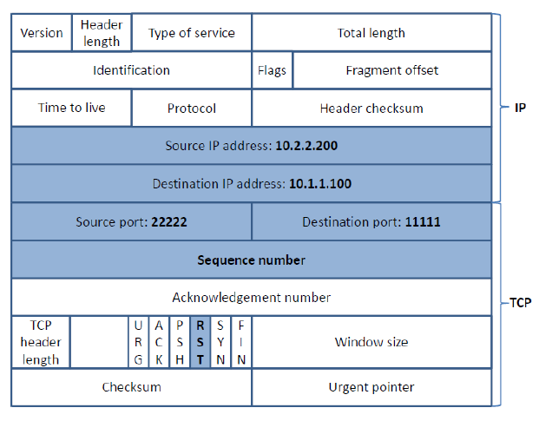
TCP Reset Attack (cont’d)
  Building the Spoofed RST Packet
Information needed for spoof:
1. Source IP address
2. Destination IP address
3. Source port
4. Destination port
5. Sequence Number
Notes:
To construct a TCP RST packet for a successful attack, the following information is needed
1. Source IP address
2. Destination IP address
3. Source port
4. Destination port
5. Sequence Number
In other words, you want to construct a TCP RST packet, which will be accepted by the receiver, either the Telnet client and the Telnet server.

Slide 13
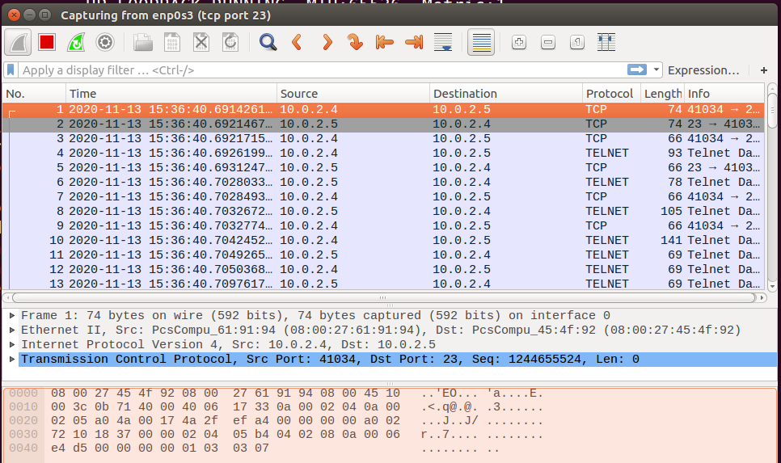
Capturing packets with Wireshark
Notes:
In order to figure out all the information needed to construct a TCP RST packet for a successful attack, you need to sniff the telnet traffic exchanged between the client and the server. As such, you can use Wireshark to capture telnet traffic on either the Telnet client or the Telnet server to analyze the packets.

Slide 14
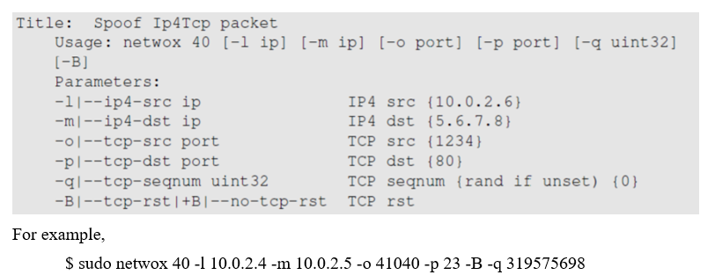
Netwox
Notes:
We will first use the No. 40 Netwox tool.
Using netwox tool 40, we can generate a spoofed RST packet to the Telnet client or the Telnet server.
In order to launch a successful TCP RST Attacks on an established telnet connection, you will need to figure out some important information about the telnet session, including the source port number, the source IP address, the destination port, the destination IP address, and sequence number), which are needed to construct a TCP RST packet for a successful attack.

Slide 15
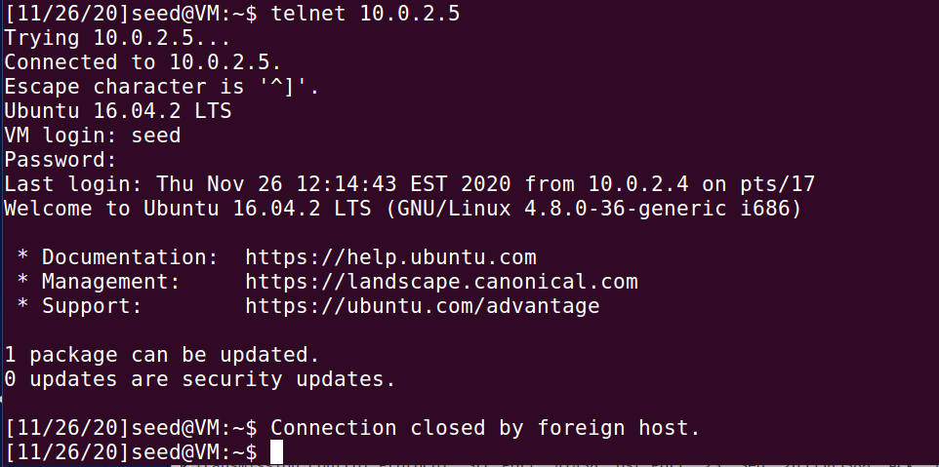
The TCP connection is closed by a spoofed TCP reset packet
Notes:
If the attack is successful, when you type any new command into the telnet session, you should see a message saying “connection closed by foreign host” indicating that the connection is broken.
In reality, the TCP connection is closed by a spoofed TCP reset packet

Slide 16
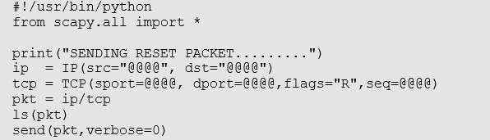
Build Your Own Tool
reset.py
sudo ./reset.py
Notes:
Next, we will build our own tool using Scapy to launch a TCP RST Attacks on an established telnet connection.
A skeleton python code using Scapy is provided to you, and you will need to replace each @@@@ with an actual value.
In other words, similar to what you did using netwox tool 40, you also need to figure out some important information about the telnet session, including the source port number, the source IP address, the destination port, the destination IP address, and sequence number).
After you have completed your attacking tool, you can launch a TCP RST attack by typing
sudo ./reset.py

